Slide 1


Data visualization
Empowering business with effective insights

Slide 2
Content slide
INTRODUCTION
THROUGHT PROCESS
DATA VISUALIZATION
RECOMMENDATIONS

Slide 3

INTRODUCTION
INTRODUCTION TO PROVIDED DATA

Slide 4
Introduction
My title is Madhu Sudhan Kambam, and I would like to tell you a little bit about your business. Thank you for asking those challenging questions. It was helpful to see the kinds of insights you might anticipate from the data. It is my sincere hope that the study will convince and prove helpful to you as you make decisions regarding your next business opportunities.
I want to start by assuring you that I have given the most accurate and current analysis. I cleaned up any records with negative quantities and unit prices after loading the data into my software, since it was necessary to do so in order to give useful analysis.

Slide 5

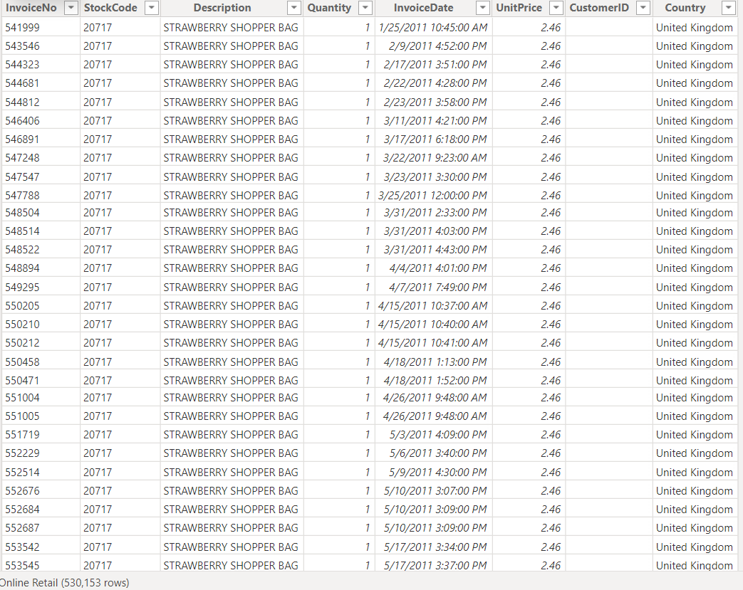
Introduction

Slide 6

Slide title 29
THROUGHT PROCESS
Data Preparation

Slide 7

Data preparation
Before we begin the analysis, we must make sure the data is clean and without errors. We used Excel to clean the dataset with the following steps:
Removed Rows in the Quantity column showing negative numbers or below 1
Removed Rows in the UnitPrice column that are below $0
Removed Rows with blanks
Added Revenue Column from multipling UnitPrice with Quantity

Slide 8
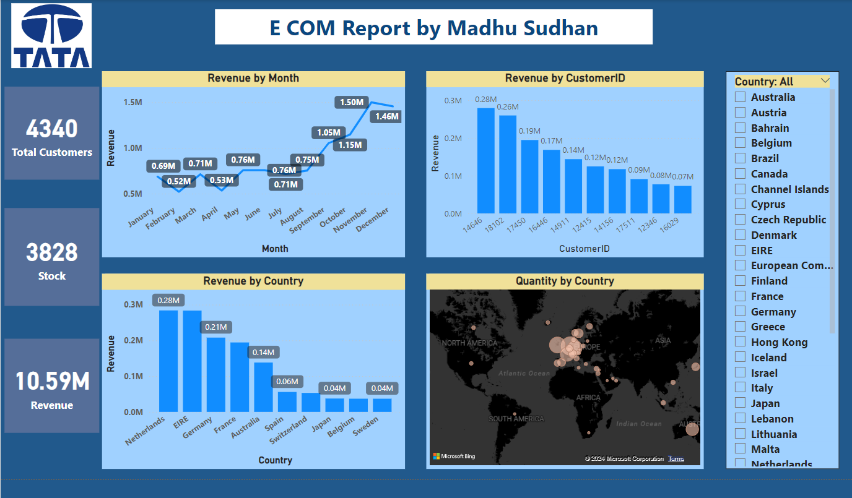
Over view

Slide 9
Slide title 29
DATA VISUALIZATION
VISUALIZATION WITH INSIGHTS

Slide 10
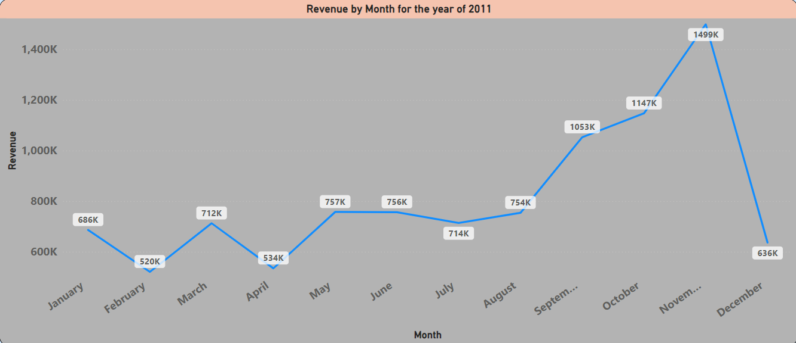
Top 10 Country by Revenue
Profitable Months are Jan to Aug, average monthly revenue is $685K stable performance during this period.
September revenue increases by 40% compared to August ,positive trend observed.
November is Peak, Highest revenue of the year: $1.5 million likely influenced by holiday season.
December Data is insufficient for conclusive insights, Exercise caution when interpreting December results.
Last four months (Sep to Dec) show significant variations seasonal trends affect retail sales.

Slide 11
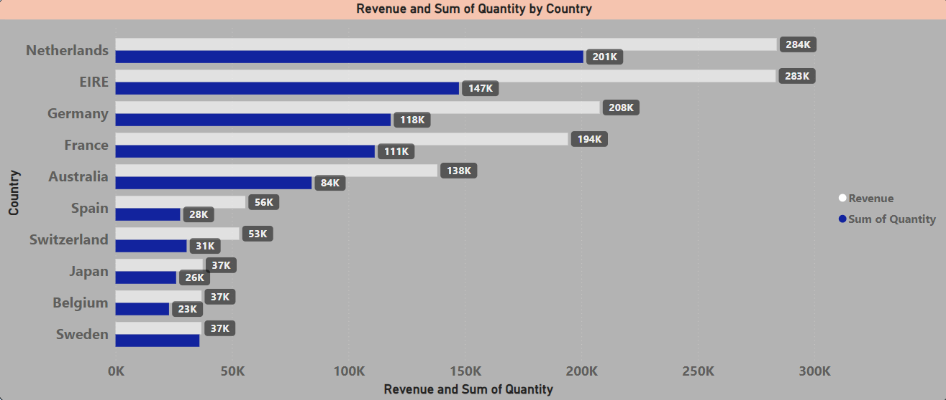
Top 10 Countries by quantity sold
The top 10 countries with growth potential exclude the UK.
Sales and income are high in the Netherlands, Ireland, Germany, and France.
Focusing on these nations can be strategic for business expansion.

Slide 12
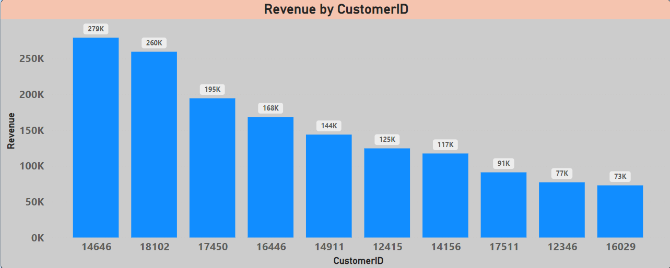
Top 10 Country by Revenue
REVENUE BY CUSTOMERID
The top 10 consumers have similar purchase patterns.
The highest revenue-producing consumer spent only 17% more than the second highest.
The company’s income isn’t solely dependent on a small group of consumers.
Limited consumer negotiation ability indicates a positive business state.

Slide 13
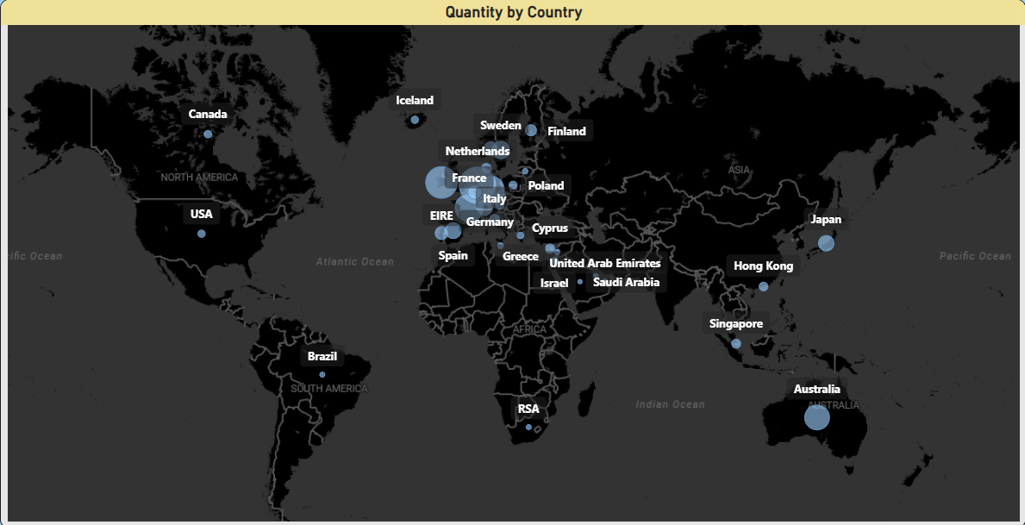
Revenue by Country
Profitable Regions are Netherlands, Ireland, Germany, France, and Australia generate substantial revenue. Consider increased investment in these nations.
Most sales occur within Europe. Limited sales in the American region.
Africa and Asia show minimal market presence. Implement targeted strategies for growth.

Slide 14
Recommendations
When demand for certain products increases, the company should develop methods to maximize sales by preparing and promoting seasonal products.
company has to do a more thorough examination of items that are typically in high demand during months with low sales.
To guide area-specific advertising strategies, a closer look at the kinds of products sold in each region and the money made from them would be essential.
To improve relationships with its top revenue-generating clients, the business needs to think about offering rewards.
The European market presents significant opportunities for expansion, and the business needs to look into strategies that focus on enhancing its market positioning within the region.

Slide 15

Thank you

